Slide 1
Pathogen Genomics
Module 4: De novo genome assembly
Stephen Doyle
LSHTM
26th April 2019

Slide 2
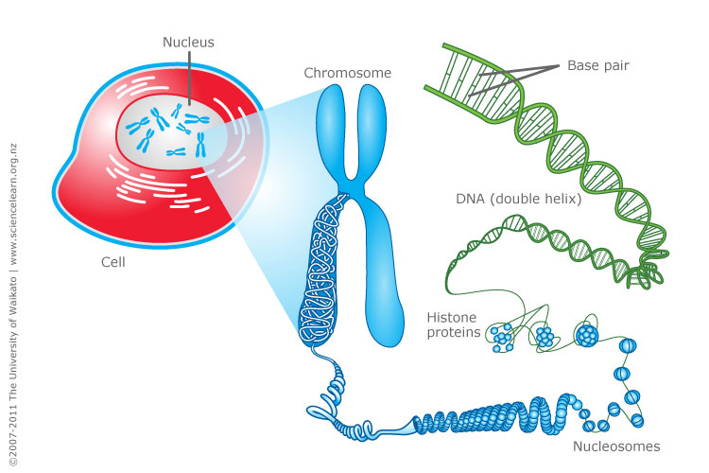
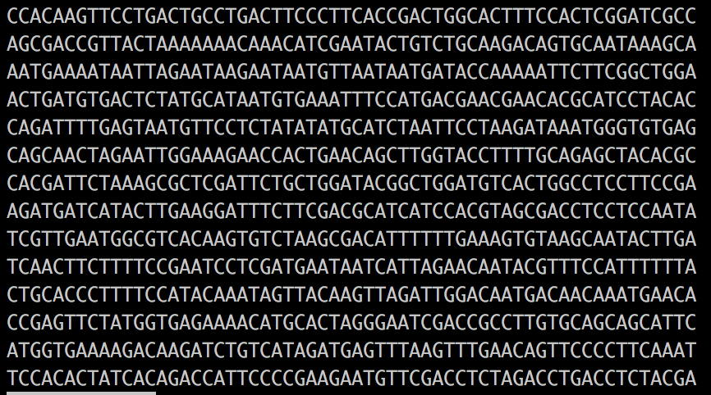

Genome sequencing is conceptually straight forward
https://www.sciencelearn.org.nz/images/198-cell-chromosomes-and-dna

Slide 3
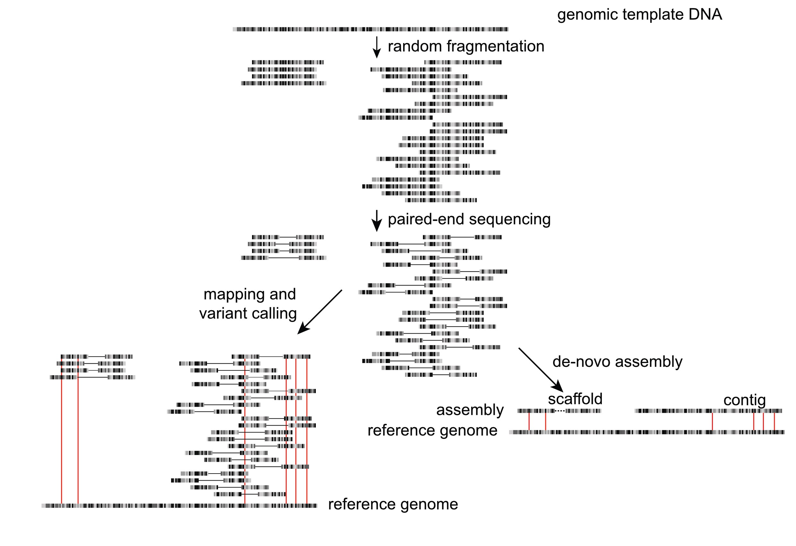
Sequencing genomes is easy…!
Sample / library preparation
Sequencing
Informatics

Slide 4
Sequencing genomes is easy, constructing good genomes is not
Genome: biologically
“the haploid set of chromosomes in a gamete or microorganism, or in each cell of a multicellular organism”
“the complete set of genes or genetic material present in a cell or organism”
Adapted from Torsten Seemann presentation: “De novo genome assembly”
https://www.slideshare.net/torstenseemann/de-novo-genome-assembly-tseemann-imb-winter-school-2016-brisbane-au-4-july-2016

Slide 5
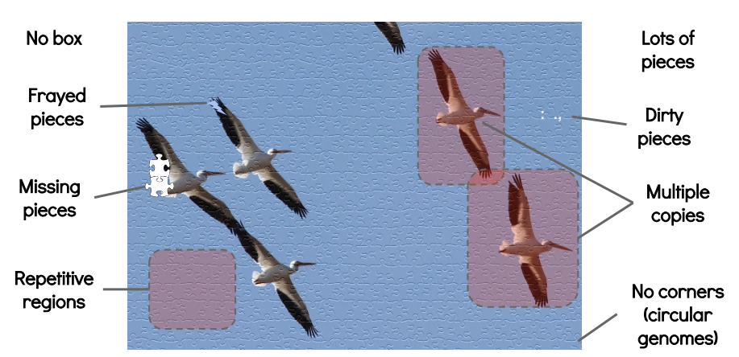
Sequencing genomes is easy, constructing good genomes is not
Genome: bioinformatically
Best guess, but often:
highly fragmented
misassembled to some degree
Haplotypic
contaminated
duplicated or missing
Chromosome-scale
genomes
HARD
Draft genomes
“manageable”(?)
Time, money, expertise
Adapted from Torsten Seemann presentation: “De novo genome assembly”
https://www.slideshare.net/torstenseemann/de-novo-genome-assembly-tseemann-imb-winter-school-2016-brisbane-au-4-july-2016

Slide 6

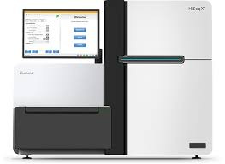
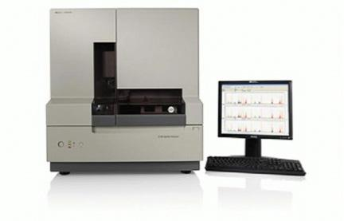
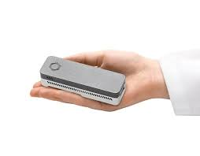
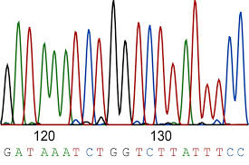
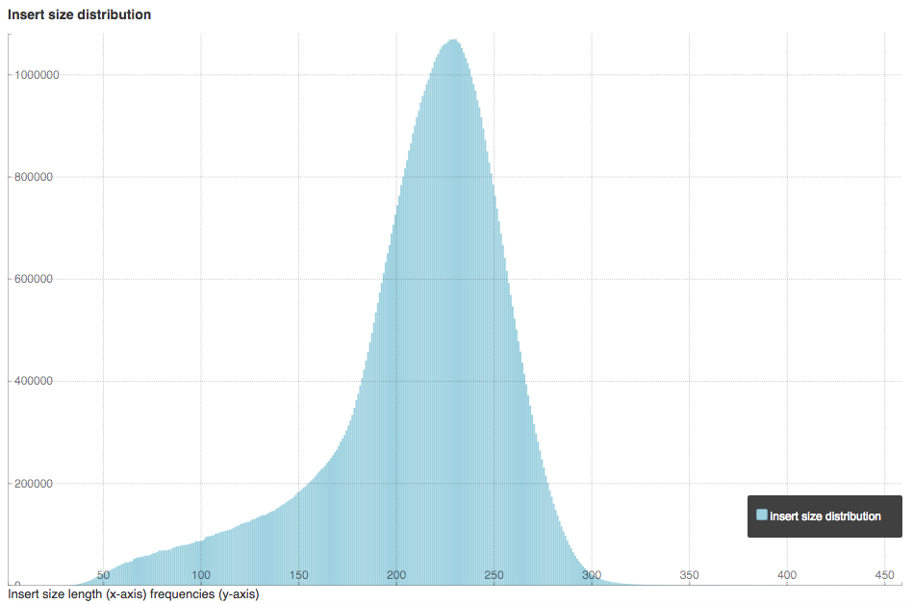
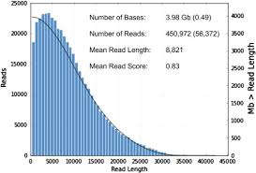
New technologies are making genome assembly easier
Sanger Sequecing: ABi
High Throughput Sequencing: Illumina
Long read sequencing: Pacbio & Nanopore
Read length:500-1000 bp
Read lengths: 100-300 bp
Insert lengths: ave 300-500 bp
Read lengths: 5-10 kb
- Pacbio: up to 60 kb
- Nanopore: up to 1Mb

Slide 7
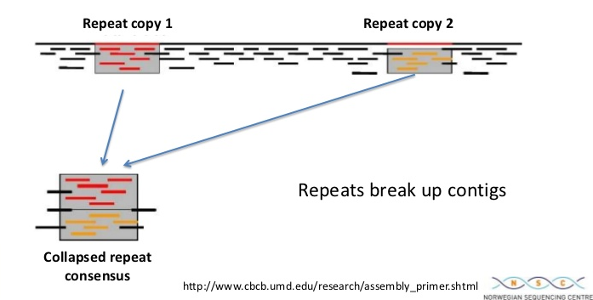
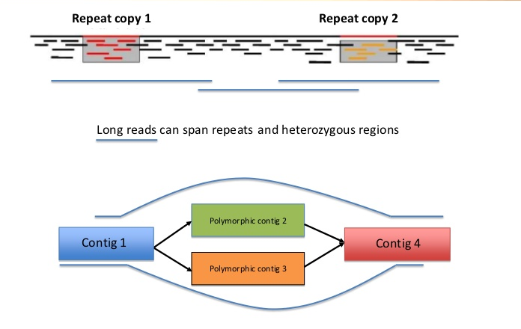
Repeats / polymorphic loci can break genomes
https://www.slideshare.net/flxlex/combining-pacbio-with-short-read-technology-for-improved-de-novo-genome-assembly

Slide 8
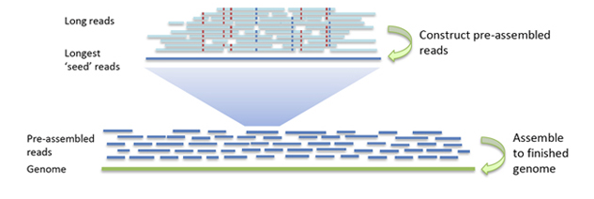
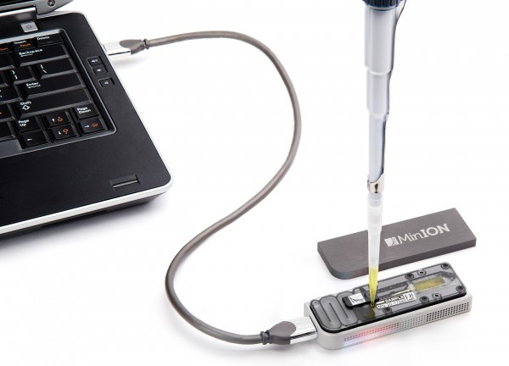
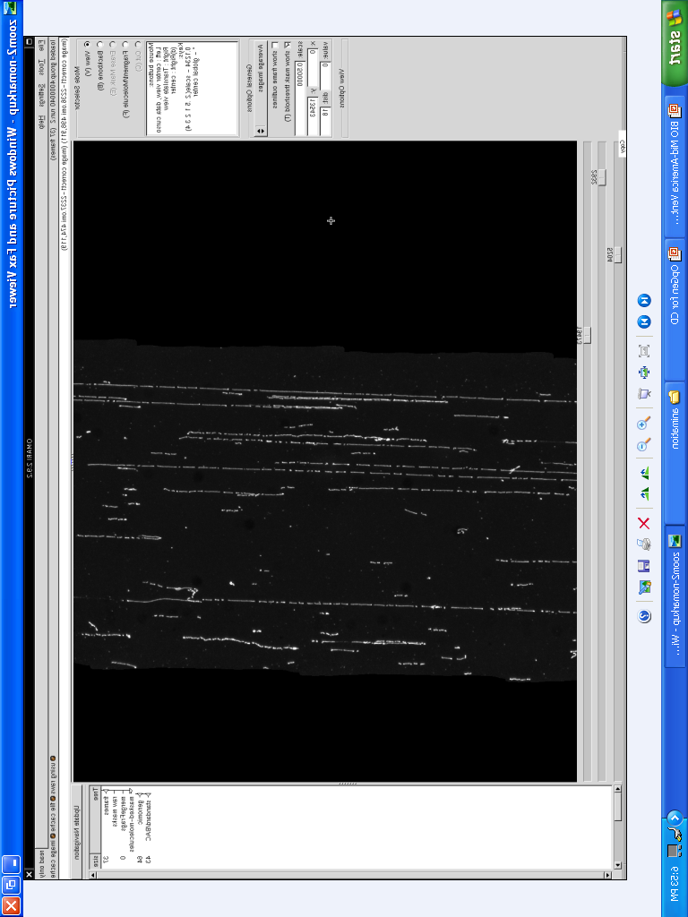
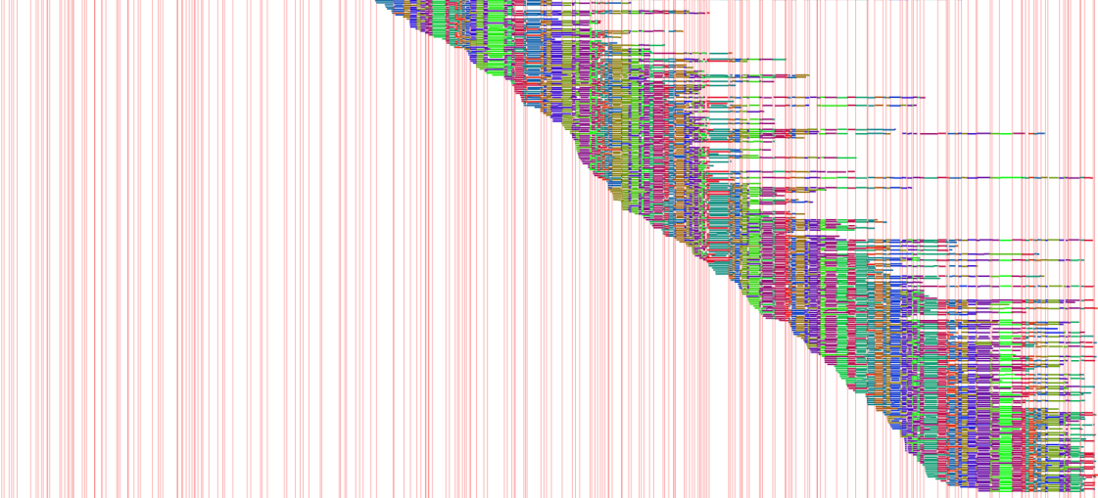
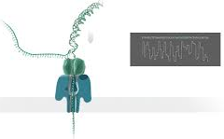
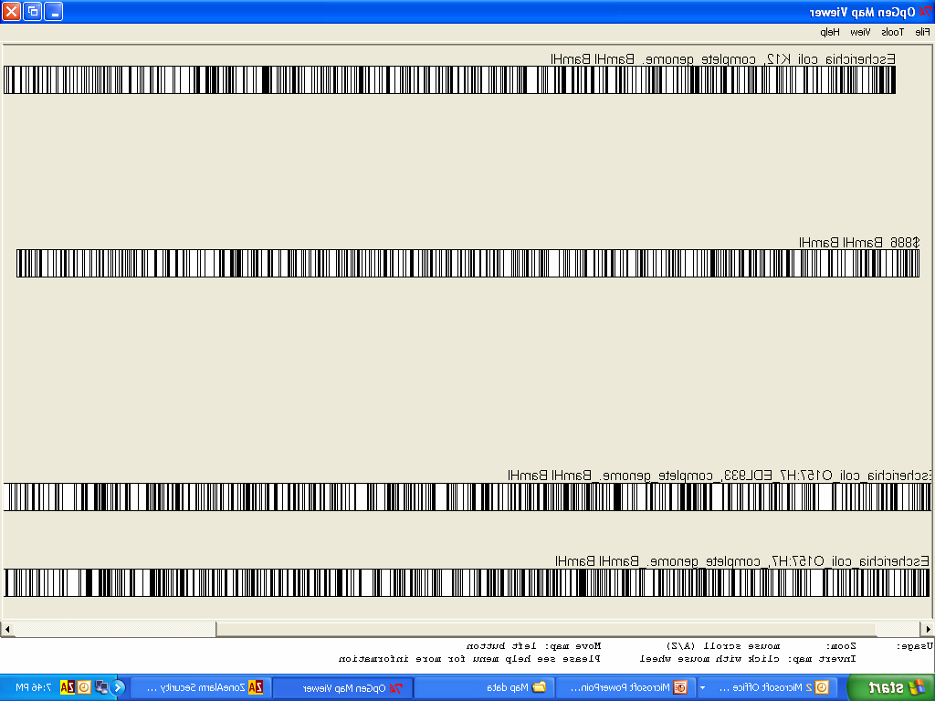
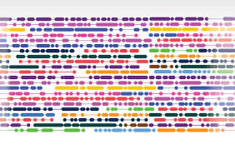
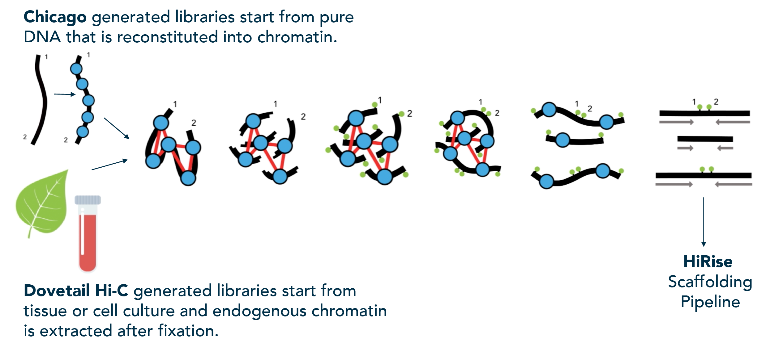

Long read / range sequencing is key to good genomes
Pacific Biosciences (PacBio)
Oxford Nanopore
Optical Mapping (OpGen, Bionano genomics)
Linked reads (10X Genomics)
consensus map
Chromosome confirmation capture, ie Hi-C (Dovetail Genomics)

Slide 9
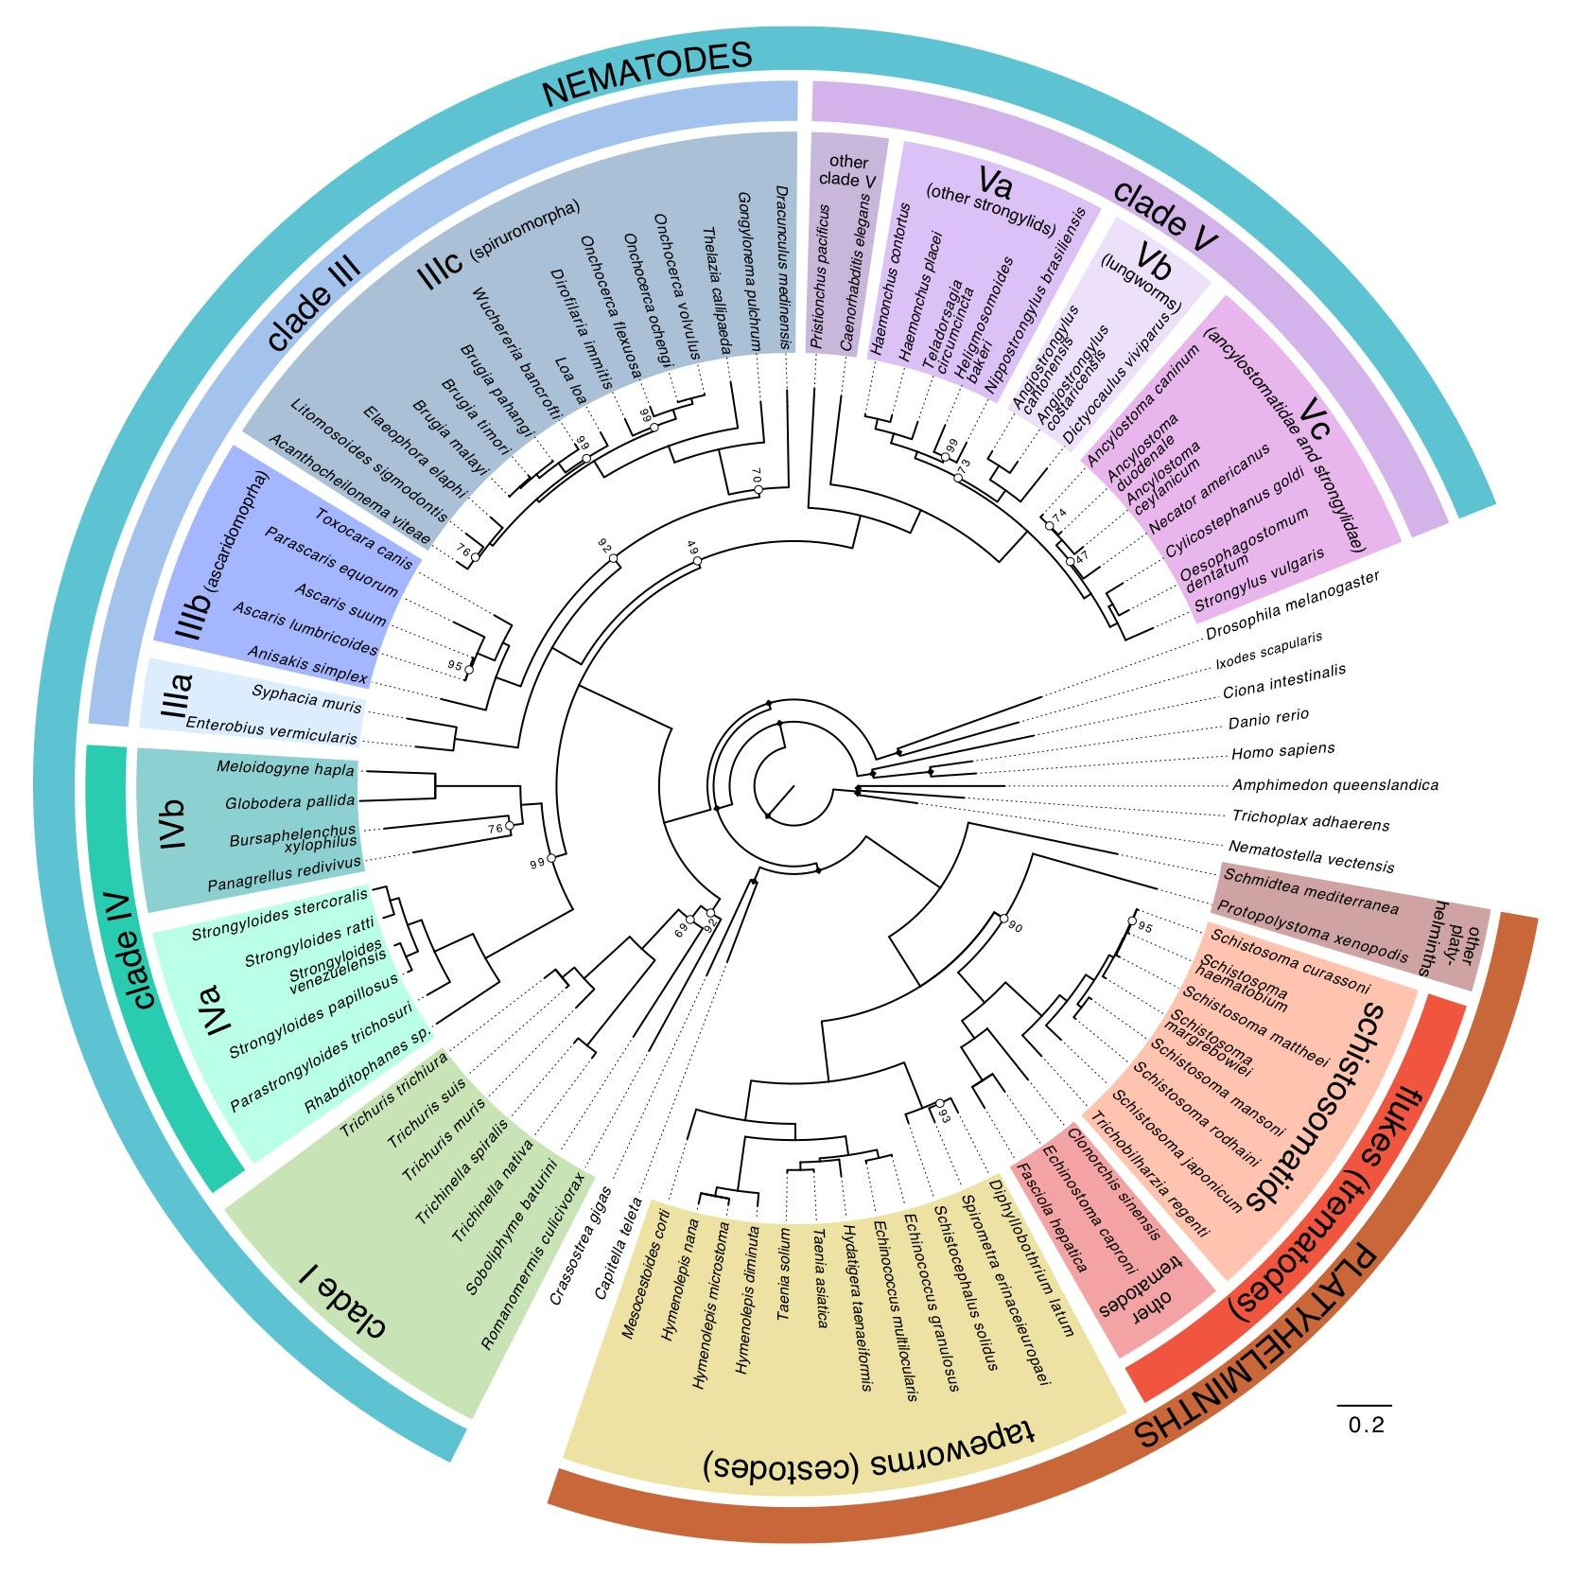
Parasite Genomics @ Sanger: 50 Helminth Genome Project
Aims:
generate draft genome assemblies for (a) clinically and veterinary important organisms and (b) parasitic groups lacking exemplars in current genome projects and (c) comparators to ‘reference’ species
(Try to) ensure similar sequencing, assembly and annotation approaches for each genome so they are truly comparable

Slide 10
Not all helminths, nor their assemblies, are created equal
N50 (bp)
N50 (n)
N50: measure of contiguity. The minimum sequence length for which 50% of the genome is in sequences at least this length

Slide 11
Chromosomal scale helminth assemblies
 | Samples / biology | Sequencing | Stage | Genome size (Mb) | Fragments | N50 (Mb) | N50(n)
Onchocerca volvulus | Single worm | SR, optical map | final | 97 | 715 | 25.5 | 2
Trichuris muris | Pooled worms, inbred lab strain | SR, Pacbio, optical map | PB only | 123 | 3708 | 0.140 | 193
 |  |  | final | 112 | 803 | 28.9 | 2
Trichuris trichura | Single worm (SR), 3 males (pacbio) | SR, Pacbio | PB only | 97 | 1344 | 0.257 | 98
 |  |  | final | 80 | 113 | 11.3 | 2
Hymenolepis microstoma | Inbred, clonal | Pacbio, optical map | PB only | 161 | 288 | 4.6 | 10
 |  |  | final | 164 | 27 | 21 | 3
Schistosoma mansoni | Clonal (Pacbio), single worms (SR) | SR, Pacbio, genetic map | PB only | 409 | 1598 | 1.05 | 97
 |  |  | final | 409 | 320 | 50.4 | 3
Haemonchus contortus | Pooled (PB), single worm (SR), semi-inbred, haplotypic | SR, PacBio, optical map | PB only | 487 | 5284 | 0.184 | 563
 |  |  | final | 279 | 8 | 47 | 3

Slide 12
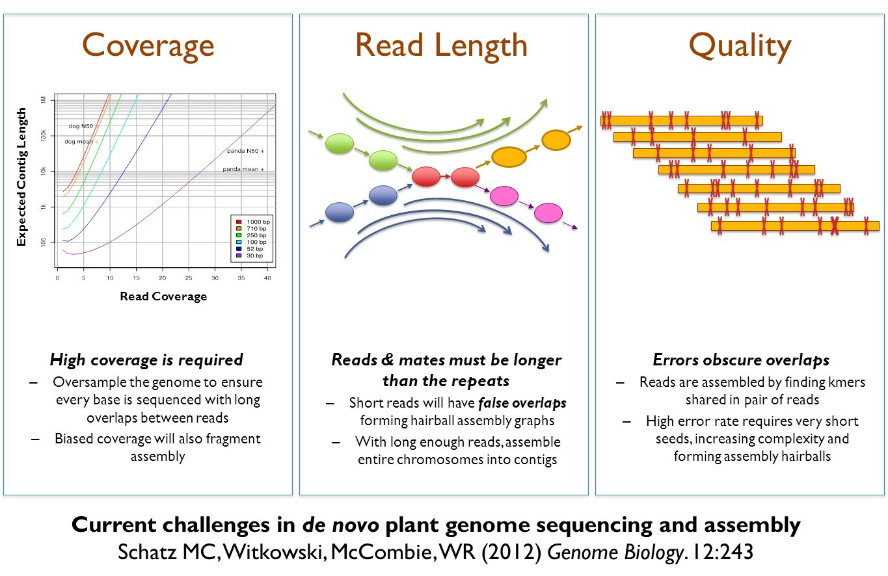
Recipe for a good genome assembly

Slide 13
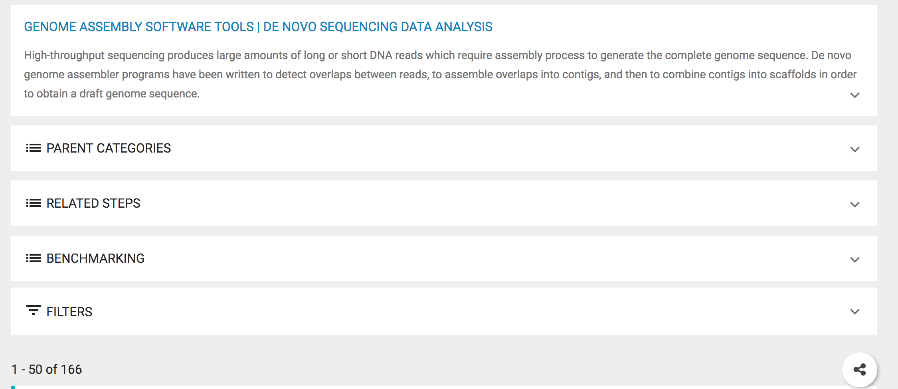
What tool(s) should I use?
https://omictools.com/genome-assembly-category

Slide 14
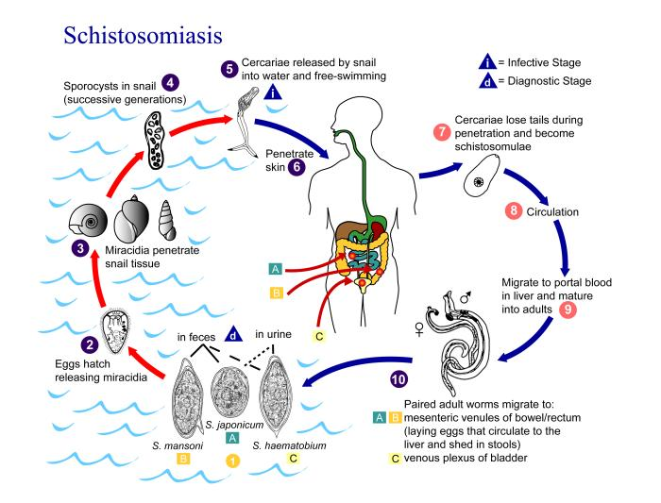
Today: Assembly of a Schistosoma mansoni chromosome
Genome
7 autosomes + Z/W sex chromosomes
approximately 380 Mb
We will work with chromosome IV
~40 Mb

Slide 15
Aims and workflow
Step 1: Checking raw sequencing data before assembly
Step 2: Estimating your genome size from raw sequence data
Step 3: Exploring different genome assembly using either Illumina short read or Pacbio long read data
Step 4: Comparison of your assemblies against a known reference sequence
Step 5: Further exploration of your genome assemblies

Slide 16
NOTE: Genome assembly is memory intensive!!!
Page 12: Unfortunately, the computers were are working on are unlikely to finish the minimap assembly.
You can skip this step, and move on to using assembly-stats to compare the pre-prepared assemblies.

